Slide 1
CIDM 6312 – Seminar in Information Visualization
HW6
SUBMITTED BY: TIWALOPE SHADARE

Slide 2
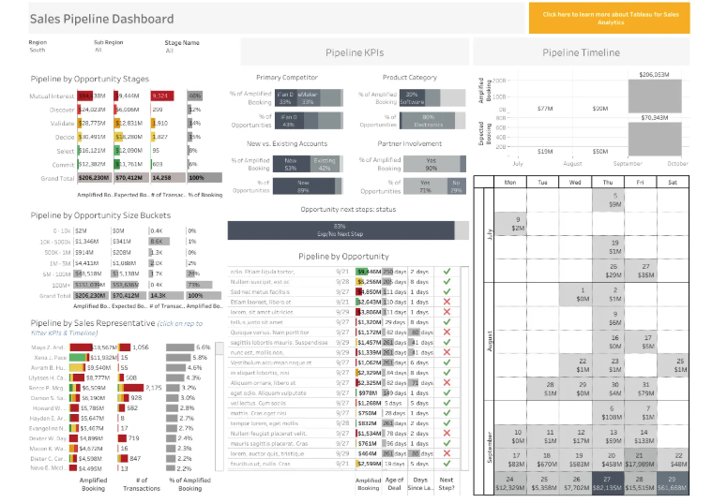
Part 1 - Dashboard Showing Sales Pipeline KPIs (Bad Example)
Goal: To showcase details and performance metrics of the Sales Pipeline
Dashboard Type: Interactive/Dynamic – Drill-down dashboard. Operational dashboard.
Brief Overview: This dashboard aims to present a detailed breakdown of essential metrics for sales representatives. While it may be complex, it offers comprehensive insights into crucial sales data related to the sales pipeline.
Hyperlink: 15 Sales Dashboard Examples [+ Tips and Templates] | Yesware

Slide 3
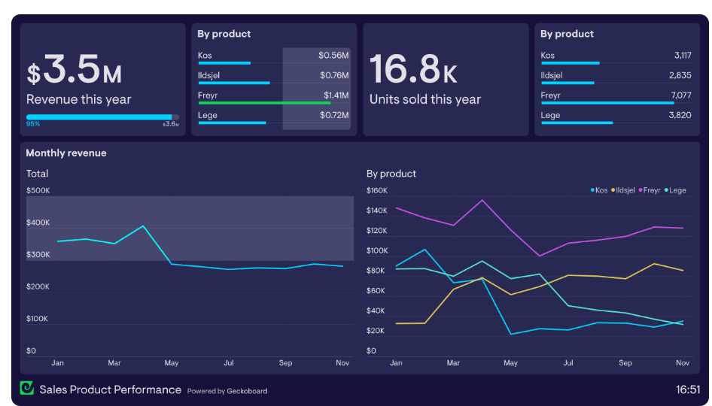
Part 1 – Dashboard showing Sales KPIs (Good Example)
Goal: To illustrate the Revenue and Performance of specific products
Dashboard Type: Static/Non-interactive Dashboard. Strategic dashboard.
Brief Overview: This dashboard offers a detailed analysis of sales performance categorized by products and brands. It also includes information on Year-to-date revenue and the monthly revenue breakdown for each product/brand.
Hyperlink: 13 Sales dashboard examples based on real companies | Geckoboard

Slide 4
Part 1 - Analysis and Criticism - Comparison
1. Clarity and Readability: The first dashboard (bad example) was cumbersome with a lot of information presented at once, it had a cluttered layout with too many charts and tables in one screen making it difficult to focus on key insights. Meanwhile, the second dashboard (good example) was well- organized, breaking down data into digestible sections like revenue, units sold e.t.c.
2. Use of Data Visualization: The first dashboard included many tables and text-heavy elements which increases the cognitive load of the audience and makes interpreting the dashboard difficult. The second dashboard effectively used bar charts and line charts for easy interpretation.
3. Use of color: The first dashboard overuses color. There were a lot of red, green, yellow and gray hues with no clear pattern causing a visual clutter. The second dashboard uses distinct colors for product differentiation and trend tracking making it visually appealing.
4. Visual Hierarchy: The first dashboard lacks clear emphasis on which key takeaway to focus on as all the elements in the dashboard compete for attention. The second dashboard used the preattentive principle of size by using big fonts and bold numbers to highlight key figures first.

Slide 5
Part 1 – Key Takeaways
1. Minimize clutter and enhance clarity: It is essential to recognize that a dashboard has limited space, making it crucial to utilize this space effectively. Presenting information in a manner that communicates the most significant message at first glance is vital, while avoiding unnecessary clutter. Employing preattentive principles to emphasize key details can significantly enhance clarity.
2. Understand your audience's needs: When designing dashboards, it is critical to identify who the audience is and the purpose behind the dashboard's creation. This understanding will allow for tailoring the dashboard to meet the specific requirements of the audience. Recognizing their needs will help focus on the information that is most relevant to them in relation to the organization's goals.
3. Thoughtful use of color: The application of color should be intentional. Both excessive and insufficient use of color can hinder the readability of charts. Moreover, color consistency across all charts within the dashboard is essential for coherence.
4. Effective data visualization techniques: Utilizing appropriate data visualization methods is crucial for effectively communicating information. For instance, time series data should be represented using a line chart to facilitate easy identification of trends. Choosing the right charts is important to ensure that the data is conveyed accurately.

Slide 6
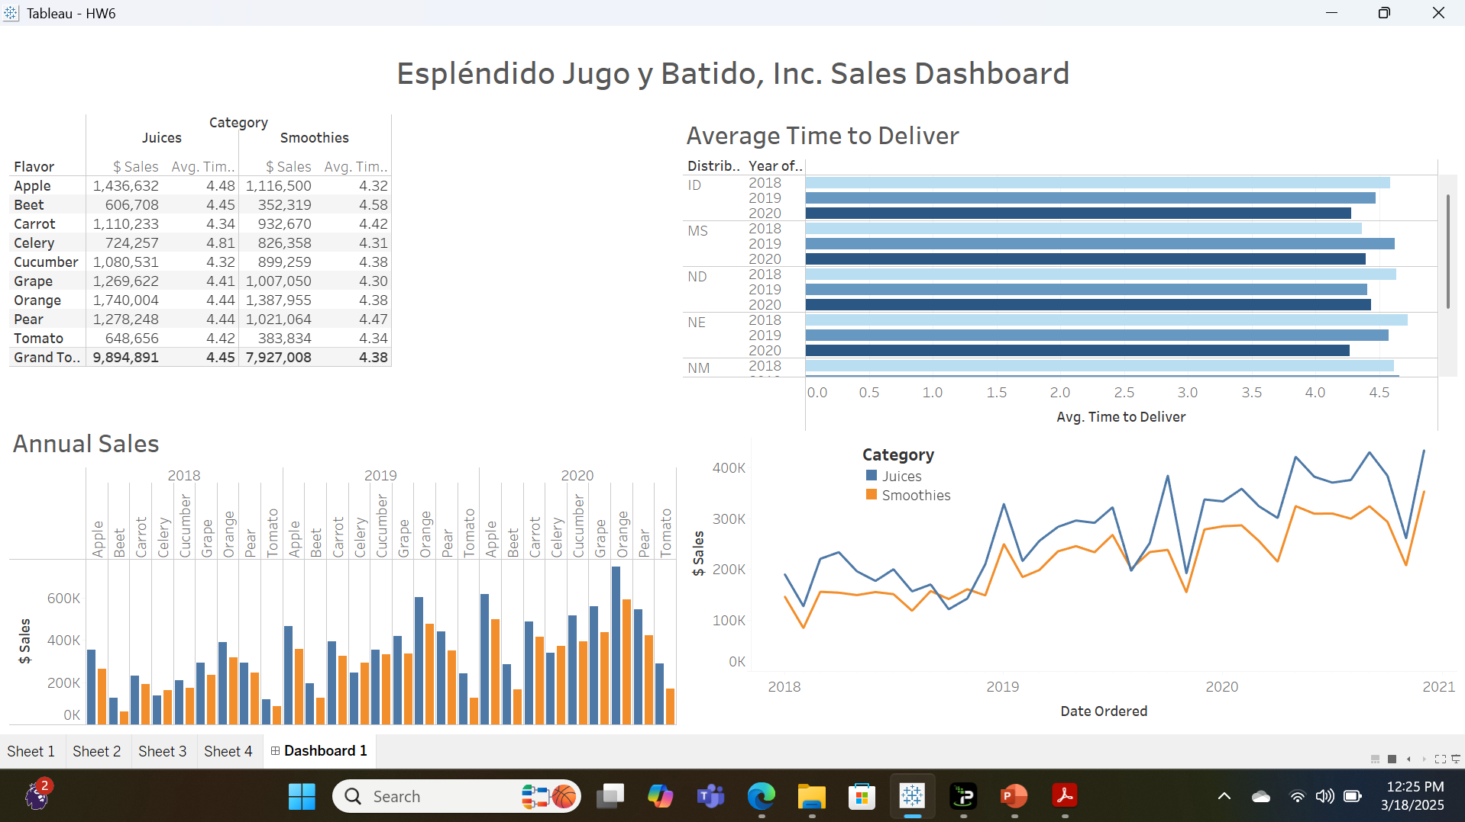
Part 2 - Dashboard showing EJB Sales KPIs by TS

Slide 7
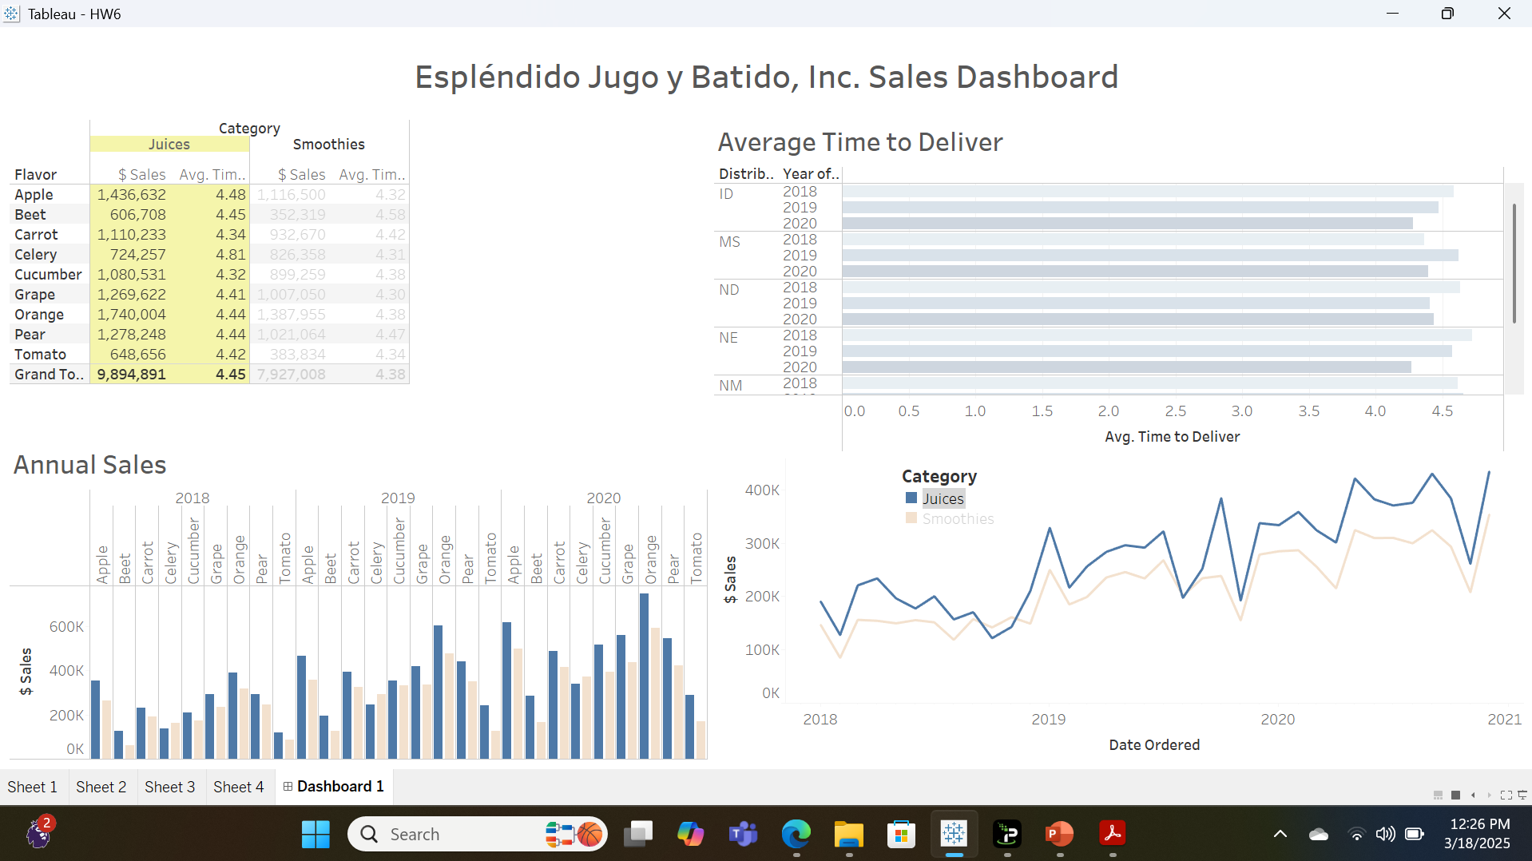
Part 2 - Dashboard showing Sales KPIs (filtered to highlight Juices) by TS

Slide 8
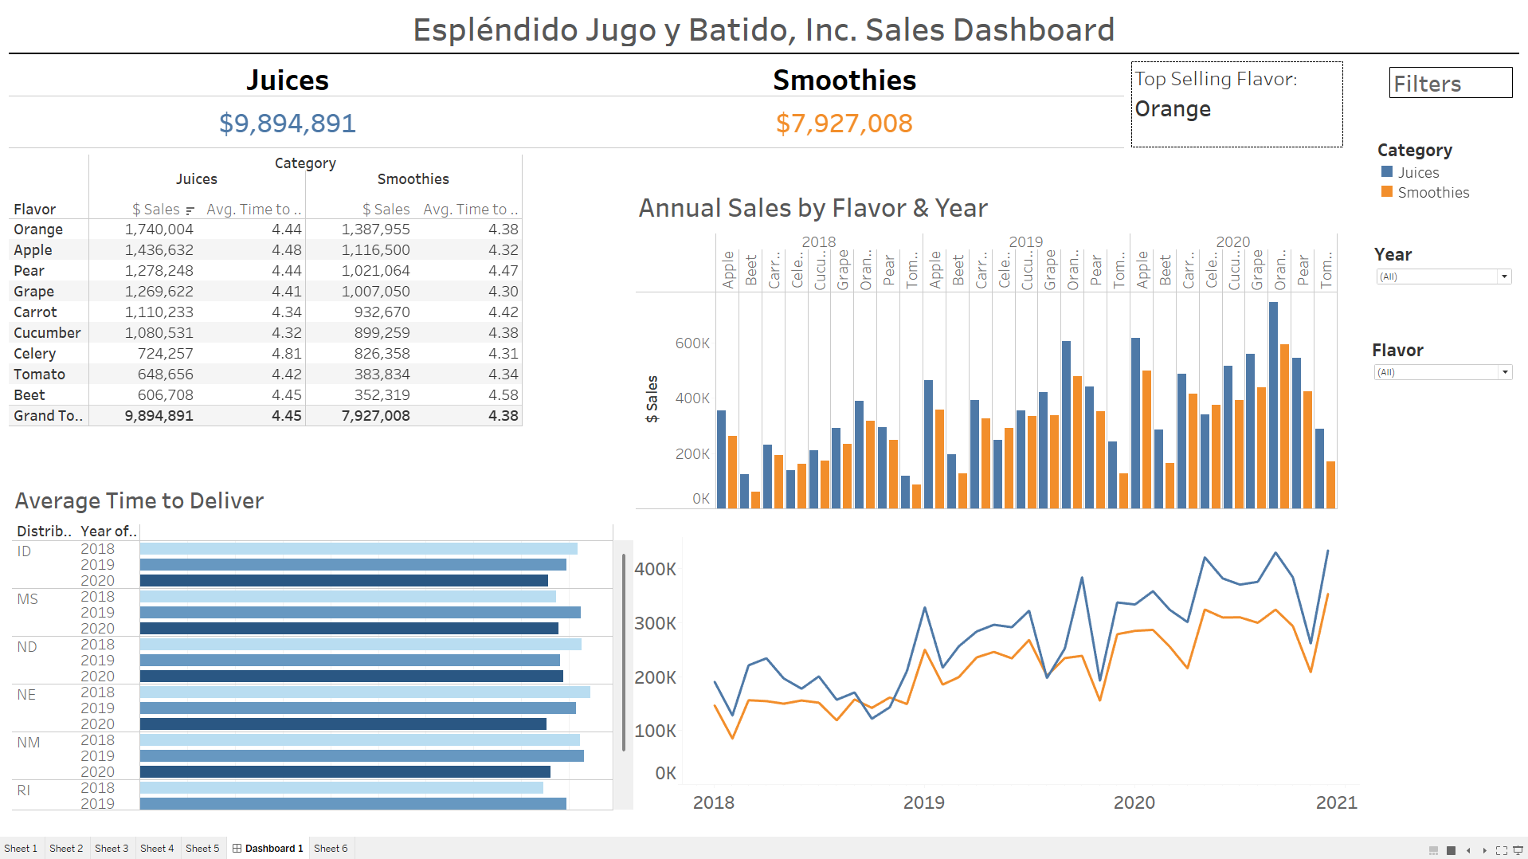
Improved EJB Sales Dashboard by TS

Slide 9
Explanation of Improvements
1. Increased interactivity: I introduced filters for years and flavors to enhance the dashboard's interactivity. This enables users to focus on a specific flavor or year to examine the relevant KPIs for that chosen flavor or year.
2. Incorporated Summary Section: While totals were included in the table, I emphasized the total revenue for Juices and Smoothies using larger fonts and a consistent color scheme. This aligns with the preattentive principles of size, allowing users to quickly grasp the revenue generated from juices and smoothies, as well as identify the top-selling flavor.
3. Minimized clutter: To declutter the dashboard, I relocated the category filter from its previous position within the line chart to the side of the dashboard. I observed that placing the filter within the chart obscured details depending on the flavor being analyzed. This adjustment has improved readability by reducing clutter.
4. Organized sales table: I sorted the sales table based on the sales performance of each flavor. This arrangement enables our audience to easily recognize that orange is the best-selling flavor, while beet is the least popular.

